Slide 1


Electronic
Medical
Records
Presented by Nate,Ghouse & Karen Limited

Slide 2

Today's Discussion
TOPICS TO BE COVERED
What's the system used for?
Which issue has it solved?
How well has it solved the
issue? - Problem Statement Definition and Reasoning
Show how multiple parties (or countries) can work together to solve the issue which
you mean to solve.

Slide 3

WHAT IS THE SYSTEM USED FOR?
The Electronic Medical Records (EMR) system is used to digitize, store, and manage patients' medical records. It enables healthcare providers to access and update patient information efficiently and securely, fostering better coordination and decision-making.
Key functionalities include:
• Recording patient histories and clinical notes.
• Managing lab results, prescriptions, and diagnostic imaging.
• Enabling secure data sharing across healthcare professionals.
• Supporting billing, scheduling, and administrative workflows.

Slide 4

Which Issue Has It Solved?
Before EMR systems, patient records were maintained in physical files, leading to several inefficiencies and risks:
• Data Accessibility: Difficulty accessing records in emergencies or across multiple providers.
• Record Integrity: Physical records were prone to damage, loss, or duplication.
• Time Delays: Manual updates and retrieval processes delayed critical decision-making.
• Coordination Challenges: Fragmented data hindered collaboration among healthcare providers.
• Errors and Miscommunication: Increased chances of human errors in transcription and communication.

Slide 5

How Well Has It Solved the Issue?
EMR systems have significantly improved healthcare efficiency and patient outcomes:
• Enhanced Accessibility: Providers can instantly retrieve patient records, even remotely, enabling timely decisions.
• Improved Accuracy: Automated data entry and integration reduce human errors.
• Streamlined Workflows: Administrative tasks like billing and scheduling are faster and more accurate.
• Better Coordination: Shared access to data fosters interdisciplinary collaboration and continuity of care.
• Compliance and Security: EMRs ensure adherence to regulatory standards (e.g., HIPAA) and provide robust data encryption.

Slide 6
While EMRs have transformed healthcare, challenges remain, such as steep learning curves for staff, high initial costs, and occasional data breaches. However, their benefits in enhancing patient safety, reducing inefficiencies, and fostering data-driven decisions outweigh the limitations, making them a cornerstone of modern healthcare systems.

Slide 7

Collaboration Between Ghana and India to Improve Healthcare Through Electronic Medical Records (EMR)
Problem Statement
Both Ghana and India face challenges in healthcare management, including fragmented patient records, limited accessibility in rural areas, and inefficiencies in medical data handling. EMR systems can provide a solution by digitizing and centralizing health information, improving accessibility and care quality.

Slide 8

In Scope
Patient Registration
Vitals
OPD Services
Consulations

Slide 9

Out of Scope
Maternity Services
Lab Services
Pharmacy
Scan Services

Slide 10


Expected Outcomes
• Improved Healthcare Delivery: Enhanced patient data accessibility for healthcare providers in both countries.
• Cost Efficiency: Economies of scale in shared development reduce the financial burden on both nations.
• Global Health Impact: Joint efforts can set a precedent for other developing nations to adopt digital health solutions through international collaboration.

Slide 11
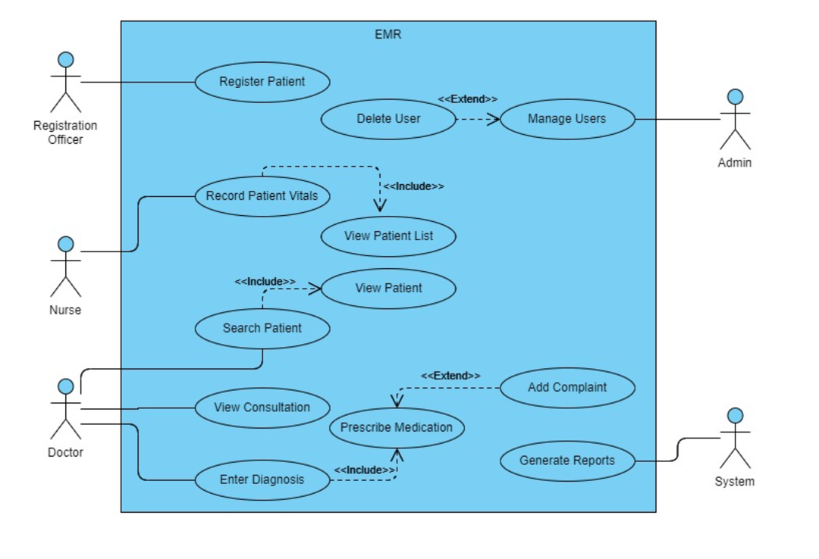

Slide 12
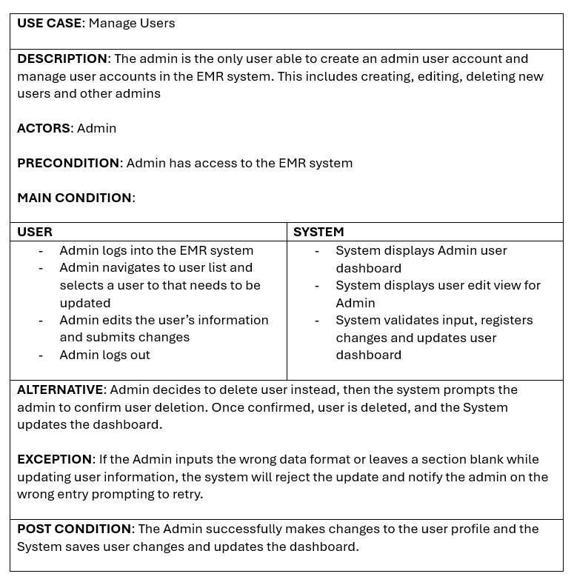

Slide 13
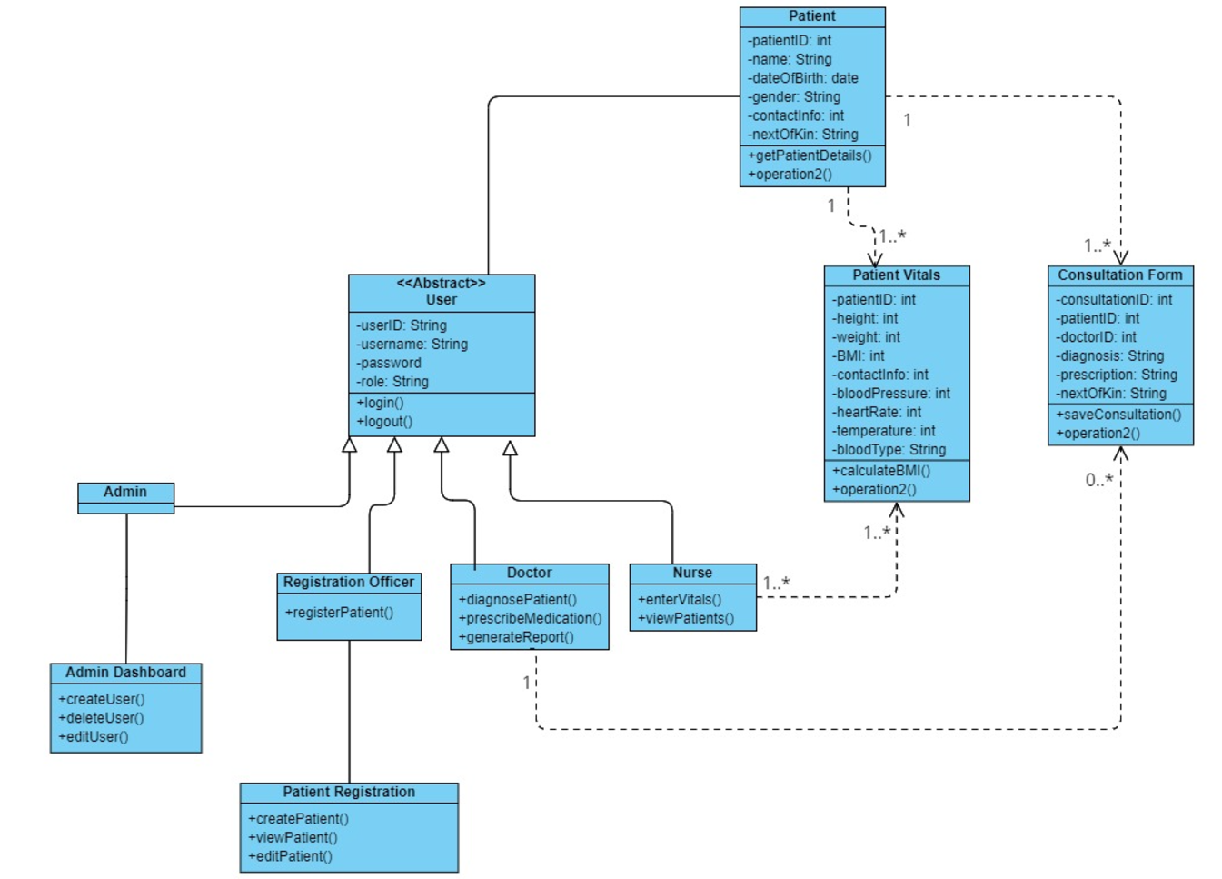

Slide 14
Thank You

